Slide 1


Connecting Alumni like Never Before
Ministry/ Organization name : Govt. of Goa Problem Statement Number/ID : DR111 Domain Bucket : Software – Web App Development Team Name : KEYCODERS 2.0 Team Leader Name : Sumit Kr Singh
College Code : 1-3509530884
ALUMNI
WEB PORTAL
DIRECTORATE
OF GOA
COLLEGE
ADMIN

Slide 2
IDEA / APPROACH DETAILS
Aimed at connecting alumni and aiding Directorate, and colleges under it with all the information, it uses MVC architecture along with a 3-level hierarchy to allow alumni’s to first register themselves and after their authentication by their respective admins they can access services through our portal.
Developed a social networking platform facilitating:
Signup, login, updating details, group chatting, creating events, notices, etc.
Approach and novelty:
SignUp and Login with API (Google, LinkedIn, Facebook) to ease the process for alumni.
Notification panel for all the activities.
Inter-college alumni association among all the 26 colleges.
For security: spam detection, password hashing, message encryption, and captcha validation.
Facility for job postings along with comments and discussions.
Payment Gateway for donation to colleges.
Curated lists of alumni based on categories like colleges, designation, job sector, subjects and roles that directorate may find interesting.
Following it, directorate and admins can mail or chat with an alumni.
Analysis factors such as employee spread, their designation, jobs and field of work through graphs, charts.
Sentimental analysis for knowing the psychological state of alumni for the present college students
Notes:
1

Slide 3









ALUMNI PANEL
Update Profile Details
Social Login For Ease in Login & Registration fetch registration details through Linkedin, Google, Facebook APIs
Chat & Group Chat with other Alumnis
Post and View Events, Notices & Comments
After Authentication, Access to all alumni portal Services
Notification Panel
for any real time updates and notices
Payment Gateway
for Donations or Fundings
Authenticate by Respective College Admin on Admin Portal

Slide 4
















ADMIN PANEL
TECHNOLOGY STACK
Can see details of only respective college alumni
Manage Alumni like Delete (due to some reasons).
Front-End
Respective College Admin will login through portal
Send Emails to group of alumni or to specific alumni
Back-End
Publish Newsletter, Events, Notices
Database
Search Alumni using different filters, like on basis of Batches, branch, location, etc.
Others
Authenticate Alumni Accept or Reject alumni request.

Slide 5








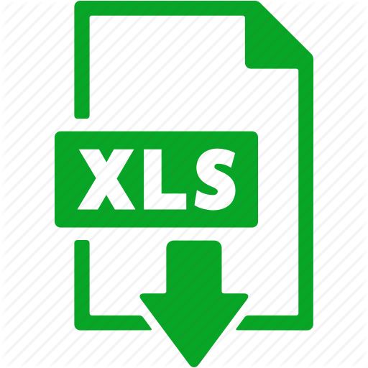


DIRECTORATE PANEL
Search Bar which filters alumni based on any type of criteria from the whole database.
Filter Alumni on the basis of batch (year-wise), current location, branch, course, current company, occupation, college, etc.
DIRECTORATE login through portal and get access to directorate panel.
Sentimental Analysis of alumni by applying Machine Learning techniques on the Feedback provided.
Powerful Map for providing the location of the alumni country-wise and applying ML to observe the pattern of preferable places.
Download the list of all or a particular group of Alumni based on filtering criteria applied either in csv, excel or pdf.
Directorate will add new colleges and Admin in future.

Slide 6
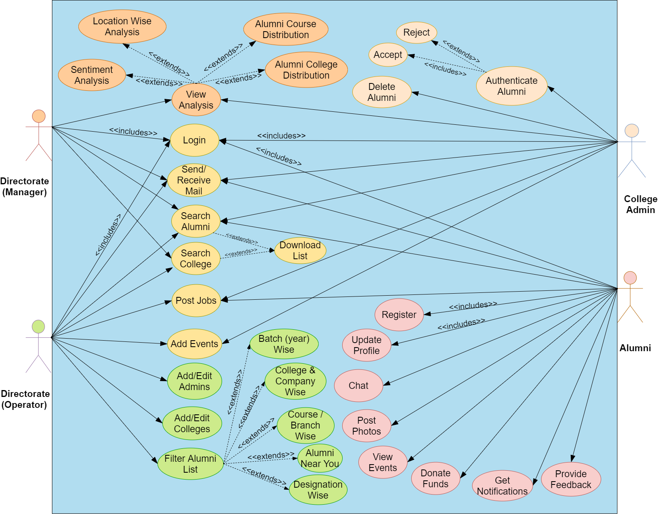

USE-CASE
Directorate
(manager, operator)
College Admins
Alumni
3-Level Hierarchy
DEPENDENCIES
External APIs.
Web Server and Hosting
Passed Out Students Data
Email and Chat Server
Technical Staff
For more info and details : http://bit.ly/keycoders2/
Notes:
1

